Slide 1
UNIT 1 INT219:FRONT END WEB DEVELOPER
Amanpal Singh Rayat

Slide 2
Syllabus
Fundamentals of HTML
Creating Style Sheet
CSS Box Model- Border properties, Padding properties, Margin properties.
Introduction to JavaScript
Working with Web Forms and validating user input
JavaScript functions and events
JavaScript Timing Events
JavaScript Image Slideshow
Recursive function in JavaScript
Error handling in JavaScript

Slide 3
1. Overview of HTML
What is HTML?
HyperText Markup Language.
The foundation of all web pages.
Used to structure content using elements/tags.
Basic HTML Structure:
<!DOCTYPE html> : Document type declaration.
<html>: The root element.
<head>: Contains meta-information (title, links, etc).
<body>: Contains the visible content.

Slide 4
Common HTML Elements:
Headings: <h1> to <h6>
Paragraphs: <p>
Links: <a>
Images: <img>
Lists: <ul> (unordered), <ol> (ordered), <li>
Divisions: <div>
Spans: <span>

Slide 5
Demonstration: Basic HTML Document
<!DOCTYPE html>
<html lang="en">
<head> <meta charset="UTF-8">
<title>My First HTML Page</title>
</head>
<body>
<h1>Welcome to My Website</h1>
<p>This is a sample paragraph.</p>
<a href="https://www.abc.com">Visit abc.com</a>
<img src="https://xyz" alt="Image">
</body> </html>
Type it in notepad:
Save as .html
Open the file in browser

Slide 6
Tags vs Elements vs Attributes in HTML
In HTML, tags represent the structural components of a document, such as <h1> for headings.
Elements are formed by tags and encompass both the opening and closing tags along with the content.
Attributes provide additional information or properties to elements, enhancing their functionality or appearance.
<p align="center">This is paragraph.</p>

Slide 7
<p> We are going to learn</p>
<a href="http://www.google.com"> link to Google </a>
</br> <hr>
<img src="2.jpg" height="50px" width="50px">
<b> Fruits </b>
<ol type="i">
<li>Apple</li>
<li>Mango</li>
<li>Banana</li>
</ol>

Slide 8
<ul type="circle">
<li>Apple</li>
<li>Mango</li>
<li>Banana</li>
</ul>
<table border= "1px" >
<tr><th>Roll</th> <th>Name</th></tr>
<tr><td>1</td> <td>aman</td></tr>
<tr><td colspan="2"> xyz</td> </tr>
</table>
<iframe src="2.jpg" height="100px" width="100px"> </iframe>

Slide 9
HTML Tags | HTML Elements | HTML Attributes
HTML tags are used to hold the HTML element. | HTML element holds the content. | HTML attributes are used to describe the characteristic of an HTML element in detail.
HTML tag starts with < and ends with > | Whatever written within a HTML tag are HTML elements. | HTML attributes are found only in the starting tag.
HTML tags are almost like keywords where every single tag has unique meaning. | HTML elements specifies the general content. | HTML attributes specify various additional properties to the existing HTML element.
Tags define the type of HTML element (e.g., heading, paragraph). | Elements represent the complete, functional unit on a webpage. | Attributes provide extra information or settings for elements.

Slide 10
Static vs Dynamic websites
Static Website | Dynamic Website
Prebuilt content is same every time the page is loaded. | Content is generated quickly and changes regularly.
It uses the HTML code for developing a website. | It uses the server-side languages such as PHP,SERVLET, JSP, and ASP.NET etc. for developing a website.
It sends exactly the same response for every request. | It may generate different HTML for each of the request.
The content is only changed when someone publishes and updates the file (sends it to the web server). | The page contains "server-side" code which allows the server to generate the unique content when the page is loaded.
Flexibility is the main advantage of static website. | Content Management System (CMS) is the main advantage of dynamic website.

Slide 11
2: Introduction to CSS
What is CSS?
Cascading Style Sheets.
Used to style and present HTML elements.
Separates presentation from content.
CSS Selectors:
Element selector (e.g., p, h1).
Class selector (e.g., .my-class).
ID selector (e.g., #my-id).

Slide 12
CSS Properties:
color
font-size
background-color
text-align
And many more...

Slide 13
How to Add CSS
Inline CSS (inside HTML tags using style attribute).
Internal CSS (<style> tag inside the <head>).
External CSS (.css file linked to HTML using <link>).

Slide 14
Demonstration: Styling HTML using Internal CSS
<html> <head>
<title>Styling with CSS</title>
<style>
h1 { color: blue; text-align: center; }
p { font-size: 1.2em; color: green; } </style>
</head> <body>
<h1>Styled Heading</h1>
<p>This paragraph is styled with CSS.</p> </body> </html>
Type it in notepad:
Save as .html
Open the file in browser
Unlike pixels (px), "em" is a relative unit, meaning it scales proportionally based on the parent element's font size

Slide 15
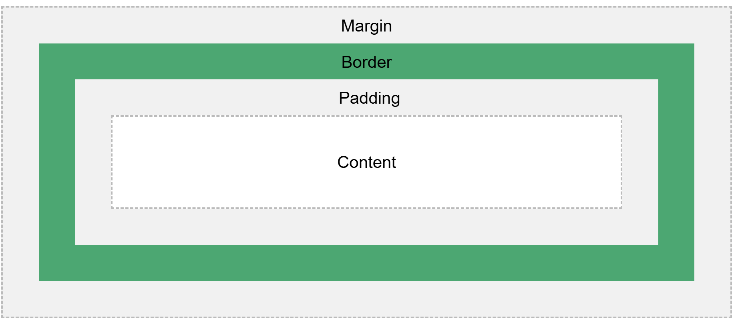
4. CSS Box Model
box that wraps around every HTML element.
consists of: content, padding, borders and margins.

Slide 16
Every HTML element is treated as a rectangular box.
Content - where text and images appear
Padding - Clears an area around the content. - it is transparent
Border - goes around the padding and content
Margin - Clears an area outside the border. - it is transparent

Slide 17
Border Properties:
border-width border-style border-color
Padding Properties:
padding-top padding-right padding-bottom padding-left Shorthand padding
Margin Properties:
margin-top margin-right margin-bottom margin-left Shorthand margin

Slide 18
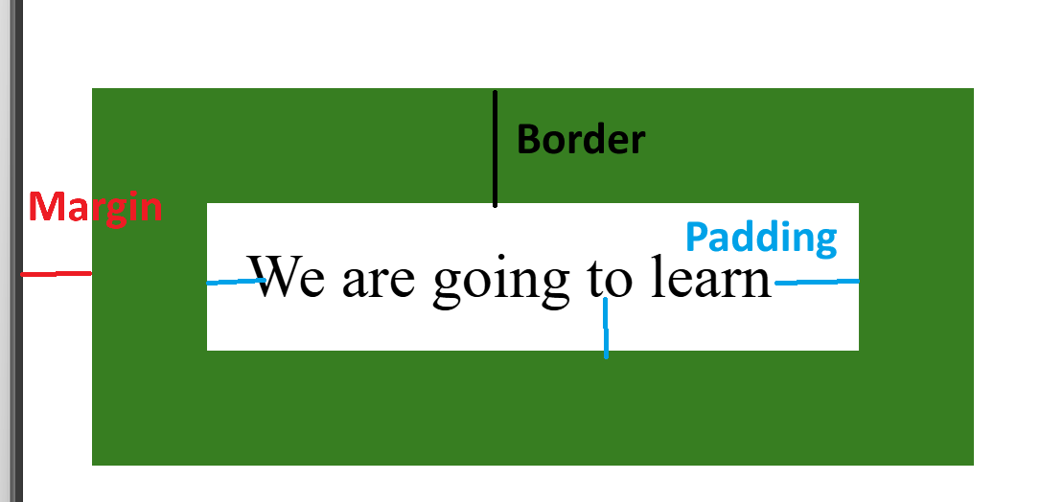
<html> <head> <style> div {
background-color: lightgrey; width: 300px; border: 15px solid green;
padding: 50px; margin: 20px; } </style>
</head> <body> <div>This text is the content of the box.</div>
</body> </html>
solid | dotted | dashed

Slide 19
Including external CSS file
<head>
<link rel="stylesheet" href="style.css"></link>
</head>

Slide 20
Demonstration: Exploring the Box Model
<html lang="en">
<title>CSS Box Model</title>
<style> .box
{ width: 200px; height: 100px; background-color: lightblue; border: 5px solid red; padding: 20px; margin: 30px; }
</style>
<body>
<div class="box">This is a box.</div>
</body>
</html>
Type it in notepad:
Save as .html
Open the file in browser

Slide 21
4: Introduction to JavaScript
What is JavaScript?
A scripting language for making web pages interactive.
Runs in the browser.
Used to handle events, manipulate HTML and CSS, make asynchronous calls etc.
How to add JavaScript:
Internal JavaScript (<script> tag inside HTML).
External JavaScript (.js file linked to HTML).
Scripting languages are interpreted, while programming languages are compiled

Slide 22
Basic JavaScript Syntax
Variables: var, let, const
Data types: Numbers, Strings, Booleans, Arrays, Objects
Operators: +, -, *, /, =, ==, ===, >, <, etc.
The var keyword was used in all JavaScript code from 1995 to 2015.
The let and const keywords were added to JavaScript in 2015.
The var keyword should only be used in code written for older browsers.
let x = 5; const x = 5; var x = 5;

Slide 23
Démonstration : Simple JavaScript Alert
<html>
<head> <title>JavaScript Intro</title> </head>
<body>
<button onclick="showAlert()">Click Me</button>
<script> function showAlert()
{ alert("Hello from JavaScript!"); }
</script>
</body>
</html>
Type it in notepad:
Save as .html
Open the file in browser

Slide 24
JavaScript Popup Boxes
Alert
Confirm
Prompt

Slide 25
5: Working with Web Forms and Validating User Input
HTML Forms:
<form> tag to create a form.
<input> tags for text, password, email etc.
<button> or <input type="submit"> to submit the form.
JavaScript Form Validation:
Check for empty fields.
Validate email format.
Validate password complexity.
etc…

Slide 26
Demonstration: Form Validation with JavaScript
<!DOCTYPE html>
<html>
<head>
<script>
function validateForm() {
x = document.forms["myForm"]["fname"].value;
if (x == "") {
alert("Name must be filled out");
return false;
}
}
</script>
</head>
<body>
<h2>JavaScript Validation</h2>
<form name="myForm">
Name: <input type="text" name="fname">
<input type="submit" onclick="validateForm()" value="Submit">
</form>
</body>
</html>

Slide 27

HTML DOM
When a web page is loaded, the browser creates a Document Object Model of the page.
When you want to access HTML elements with JavaScript.
Find the elements first, ways to do this:
Finding HTML elements by id
Finding HTML elements by tag name
Finding HTML elements by class name
Finding HTML elements by CSS selectors
Finding HTML elements by HTML object collections

Slide 28
6: JavaScript Functions and Events
JavaScript Functions:
Reusable blocks of code.
Define with function keyword.
Call function by function name and parenthesis ().
JavaScript Events:
Actions triggered by the user or the browser.
Examples: click, mouseover, submit, load.
Attach events to HTML elements using attributes like onclick.

Slide 29
Demonstration: Basic Event Handler
<html<head> > <title>JavaScript Intro</title> </head>
<body>
<p id="message">Click the button below!</p>
<button onclick="changeMessage()">Click Me</button>
<script> function changeMessage(){ document.getElementById("message").innerHTML = "The Message changed!"; } </script>
</body> </html>

Slide 30
Part 7: JavaScript Timing Events
setTimeout():
Executes a function after a specified time delay.
setInterval():
Executes a function repeatedly with a fixed time delay between each call.

Slide 31
.innerHTML
The innerHTML property sets or returns the HTML content (inner HTML) of an element:
Get the HTML content of an element with id="myP":
let html = document.getElementById("myP").innerHTML;
Change the HTML content of an element with id="demo":
document.getElementById("demo").innerHTML = "I have changed!";
Delete the HTML content of a <p> element with id="demo":
document.getElementById("demo").innerHTML = "";

Slide 32
Demonstration: Set Interval
<html lang="en"> <head> <title>JavaScript Timing Events</title> </head>
<!-- Display incremented counts on the page at every second. -->
<body>
<p id="timer">0</p>
<script> let count = 0;
setInterval(function (){ count++; document.getElementById("timer").innerHTML = count; }, 1000)
</script> </body> </html>

Slide 33
Add two numbers
<html > <body>
<form id="additionForm"> <input type="number" id="num1" required> <br> <input type="number" id="num2" required> <br> <button type="button" onclick="addNumbers()">Add</button> </form>
<p id="result"></p> <script>
function addNumbers() {
const num1 = parseFloat(document.getElementById('num1').value);
const num2 = parseFloat(document.getElementById('num2').value);
const sum = num1 + num2;
document.getElementById('result').innerText = `The sum is: ${sum}`;
document.getElementById('result').innerText = ‘The sum is:’+sum;
}
</script> </body> </html>

Slide 34
8: JavaScript Image Slideshow
Create an array of image URLs.
Keep track of the current image index.
Use setInterval() or setTimeout() to change the image.

Slide 35
Demonstration: Image Slideshow
<html> <head> <title>Image Slideshow</title> </head> <body>
<img id="slide-image" src="" alt="Slideshow" width="400">
<script>
const images = [“1.jpg”, “2.jpg”];
let curImgInd = 0;
function changeImage(){ document.getElementById("slide-image").src = images[curImgInd]; curImgInd = (curImgInd + 1) % images.length; }
setInterval(changeImage, 2000)
</script> </body> </html>
<!--Strings created with single or double quotes work the same-->

Slide 36
9: Recursive Functions in JavaScript
A function that calls itself during its execution.
Must have a base case to avoid infinite recursion.

Slide 37
Demonstration: Recursive Function
<html><head> <title>Recursive Function</title> </head> <body>
<p id="factorial"></p>
<script> function factorial(n) {
if (n === 0) { return 1; } // Base Case
else { return n * factorial(n - 1); } // Recursive case
}
document.getElementById("factorial").innerHTML = "Factorial of 5 = "+ factorial(5) </script>
</body> </html>

Slide 38
JavaScript Comparison operator
x = 5;
equal to
x == 8 false x == 5 true x == "5" true
equal value and equal type
x === 5 true x === "5" false

Slide 39
10: Error Handling in JavaScript
The try statement defines a code block to run (to try).
The catch statement defines a code block to handle any error.
The finally statement defines a code block to run regardless of the result.
The throw statement defines a custom error.

Slide 40
try catch
<html> <body> <h2>JavaScript Error Handling</h2>
<p>How to use <b>catch</b> to display an error.</p>
<p id="demo"></p>
<script>
try { adddlert("Welcome guest!");}
catch(err) { document.getElementById("demo").innerHTML = err.message; }
</script>
</body>
</html>

Slide 41
try-throw-catch-finally
<html> <body> <p>Please input age:</p> <input id="age" type="text">
<button type="button" onclick="myFunction()">Test Input</button>
<p id="msg"></p> <p id="demo"></p>
<script> function myFunction() { const message = document.getElementById("msg");
message.innerHTML = ""; <!-- Remove previous errors-->
let x = document.getElementById("age").value;
try { if(x.trim() == "") throw "empty";
}
catch(err) {
message.innerHTML = "Input is " + err; }
finally { document.getElementById("demo").innerHTML = "xx"; }
} </script></body></html>

Slide 42
try-throw-catch-finally
<html> <body> <p>Please input age:</p> <input id="age" type="text">
<button type="button" onclick="myFunction()">Test Input</button> <p id="msg"></p>
<p id="demo"></p> <script> function myFunction() {
const message = document.getElementById("msg");
message.innerHTML = ""; <!-- Remove previous errors-->
let x = document.getElementById("age").value;
try { if(x.trim() == "") throw "empty"; if(isNaN(x)) throw "not a number";
x = Number(x); if(x < 0) throw "Not Valid age"; if(x > 60) throw "retirement age";
}
catch(err) { message.innerHTML = "Input is " + err;}
finally { document.getElementById("demo").innerHTML = "xx"; }
} </script></body></html>

Slide 43
Demonstration: Error Handling
<html> <body> <p id="result"></p>
<script> try { const numerator = 10; const denominator = 0;
if (denominator === 0) {
throw new Error("Division by zero is not allowed!"); }
const result = numerator / denominator; document.getElementById('result').innerHTML = "Result is : " + result; }
catch(err){ document.getElementById('result').innerHTML = "An error occurred: " + err.message; }
</script> </body> </html>
Dividing by zero does NOT throw an error, in Javascript.

Slide 44
To Do for students
Use the browser developer tools to illustrate the behavior of
CSS, JavaScript, and the HTML structure.

Slide 45
(Revisiting): CSS selector
Class Selector (.) — targets multiple elements.
ID Selector (#) — targets a unique element.
Element Selector — targets all elements of a specific type.
Universal selector (*) is the, which applies the CSS rule to all elements on the page.

Slide 46
CSS selector Example
<html> <head> <style>
body {background-color: #5aa0e6; } //element selector
#demo { color: blue; } //id selector
.xyz{ color:chartreuse} //class selector
.xyz > div {font-size: 30px;} //<div> elements that are direct children of xyz
</style> </head>
<body>
<h1 id="demo">Welcome!</h1>
<p>This is a simple, styled section using HTML and CSS.</p>
<p class="xyz"> hii</p>
<p class="xyz"> bye</p>
</body> </html>

Slide 47
CSS Layout - float and clear
used for positioning and formatting content e.g. let an image float left to the text in a container.
left - The element floats to the left of its container
right - The element floats to the right of its container
none - The element does not float (will be displayed just where it occurs in the text). This is default
inherit - The element inherits the float value of its parent
In its simplest use, the float property can be used to wrap text around images.

Slide 48
Add on’s : CSS float layout
<html> <head>
<style> img { float: right; } </style>
</head>
<body> <h2>Float Right</h2>
<p> the text in the paragraph will wrap around the image.</p>
<p><img src="pineapple.jpg" alt="Pineapple" style="width:170px;height:170px;margin-left:15px;">
Paragraph text <br>hiii<br>bye.</p>
</body></html>

Slide 49
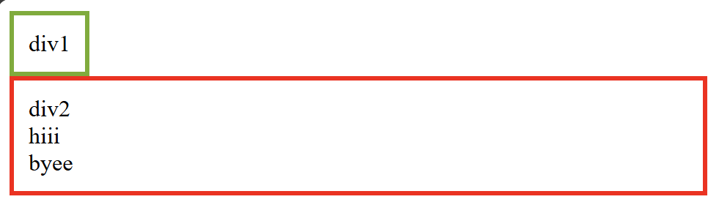
CSS clear
<html> <head> <style>
.div1 {float: left; padding: 10px; border: 3px solid #73AD21; }
.div2 {padding: 10px; border: 3px solid red; clear: left;}
</style> </head> <body>
<div class="div1">div1</div>
<div class="div2">div2 <br>hiii<br>byee<br></div>
<br><br> </body> </html>
When clearing floats, you should match the clear to the float: If an element is floated to the left, then you should clear to the left.

Slide 50
body { display: flex; justify-content: center; align-items: center; }
display: flex turns the body into a flex container.
justify-content: center horizontally centers the content.
align-items: center vertically centers the content.
This makes the section appear perfectly centered both vertically and horizontally.
With flex → The browser treats the body like a box where you control alignment.
Without flex → The browser treats the page like a document,
flowing from top-left like a Word document.

Slide 51
Example of display: flex
<html> <head> <style>
body {display: flex; justify-content: center; align-items: center;}
</style> </head>
<body>
<section class="content-section">
<h1>Welcome!</h1>
<p>This is a simple, styled section using HTML and CSS.</p>
</section> </body> </html>

Slide 52
margin property: CSS
If the margin property has four values:
margin: 10px 5px 15px 20px;
top margin is 10px
right margin is 5px
bottom margin is 15px
left margin is 20px
h1 {
margin: 0 0 30px;
}

Slide 53
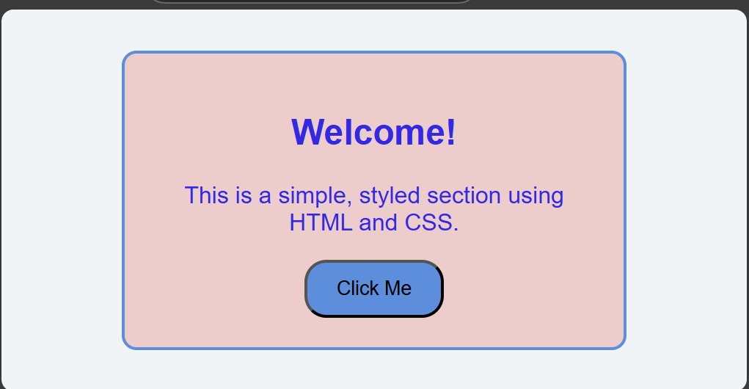
Problem 1: Build a Simple Webpage Section
Objective: Create a structured webpage section using HTML and CSS.
Instructions:
Write HTML to create a section with a heading, a paragraph, and a button.
Style the section using CSS to:
Center-align the content.
Add padding, a border, and a background color.
Use the browser’s developer tools to preview and refine the section in real-time.

Slide 54
Solution
<div> is generic and non-semantic, while <section> is semantic and defines a section of a document.
<html> <head> <style>
body {
display: flex;justify-content: center; align-items: center;
height: 100vh;
margin: 0; background-color: #f0f4f8; font-family: Arial, sans-serif; }
.content-section {
text-align: center; background-color: #f3cbcb; padding:20px;
color: rgb(54, 41, 236); border: 2px solid #4a90e2;
border-radius: 10px; width: 300px; }
.content-section button {
background-color: #4a90e2; padding: 10px 20px;
border-radius: 15px; cursor: pointer; }
.content-section button:hover {background-color: #35b869; }
</style> </head>
<body>
<section class="content-section">
<h1>Welcome!</h1>
<p>This is a simple, styled section using HTML and CSS.</p>
<button>Click Me</button>
</section> </body> </html>

Slide 55
CSS Layout
CSS Flexible Box Layout
CSS Grid Layout

Slide 56
CSS Flexible Box Layout
Flexible Box Layout module.
Arranging items in rows or columns.
Easier to design a flexible responsive layout structure
Consists of:
A Flex Container - the parent (container) <div> element
Flex Items - the items inside the container <div>

Slide 57
The CSS Flex Container
The CSS properties we use for the flex container are:
flex-direction: specifies the display-direction of flex items in the flex container.
[row, column, row-reverse, column-reverse]
flex-wrap: specifies whether the flex items should wrap or not.
[nowrap, wrap, wrap-reverse]
justify-content: used to align the flex items.
[center, flex-start, flex-end, space-around, space-between, space-evenly]
align-items: align the flex items (vertically).
[center, flex-start, flex-end, stretch, baseline, normal]

Slide 58
The CSS Flex Items
The direct child elements of a flex container automatically becomes flex items.
Properties we use for flex items are:
order: specifies the order of the flex items.
flex-grow: specifies how much a flex item will grow relative to the rest of the flex items.
flex-shrink: specifies how much a flex item will shrink relative to the rest of the flex items.
flex-basis: specifies the initial length of a flex item.
align-self: specifies the alignment for the selected item

Slide 59
Flex example
<html> <head> <style>
.flex-container { display: flex; background-color: #f1f1f1; }
.flex-container div {
background-color: #df4a4a; margin: 10px; padding: 20px; font-size: 30px;
}
</style> </head><body>
<h1>Flex Items</h1> <div class="flex-container">
<div>C</div><div>S</div><div>S</div>
</div></body></html>

Slide 60
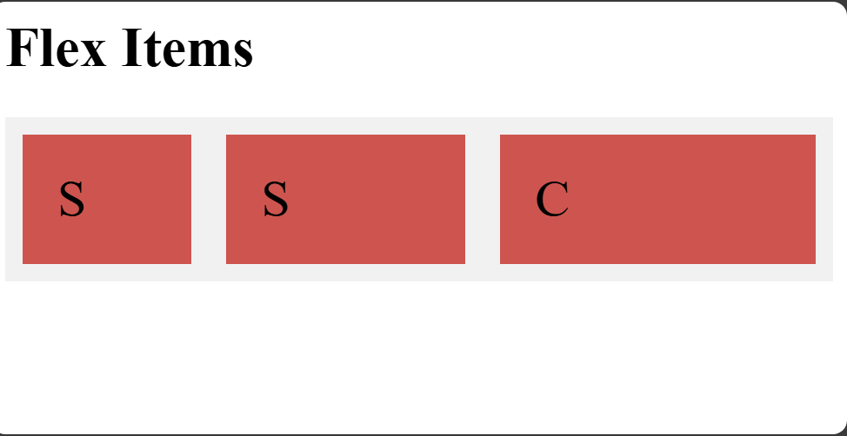
flex with attributes
<html> <head> <style>
.flex-container {display: flex; background-color: #f1f1f1; flex-direction: row-reverse; }
.flex-container div {background-color: #df4a4a; margin: 10px; padding: 20px; font-size: 30px; }
</style> </head><body>
<h1>Flex Items</h1>
<div class="flex-container">
<div style="flex-grow: 3">C</div>
<div style="flex-grow: 2">S</div>
<div style="flex-grow: 1">S</div>
</div></body></html>

Slide 61
Responsive Flexbox
<html> <head> <style>
.flex-container {display: flex;flex-direction: row; font-size: 30px; text-align: center; } .flex-container > * { background-color: #f1f1f1; padding: 10px; flex: 50%; border: 2px solid red;}
/* Responsive layout - makes a one column-layout instead of two-column*/
@media (max-width: 800px) { .flex-container { flex-direction: column; } }
</style> </head> <body>
<h1>Responsive Flexbox</h1>
<div class="flex-container"> <div >1</div> <div>2</div>
</div> </body> </html>
@media: media query and it's essential for responsive web design.

Slide 62
CSS Grid Layout
Offers a grid-based layout system, with rows and columns.
Easier to design a responsive layout structure
Grid vs. Flexbox
The CSS Grid Layout should be used for two-dimensional layout, with rows AND columns.
The CSS Flexbox Layout should be used for one-dimensional layout, with rows OR columns.

Slide 63
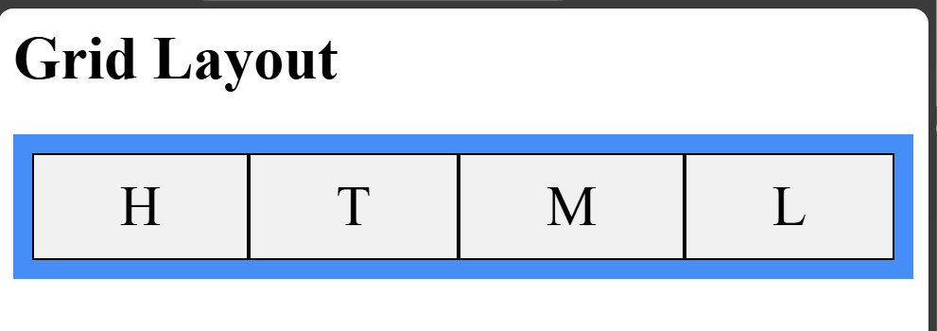
CSS Grid layout example
<html><head><style>
.container {
display: grid; grid-template-columns: auto auto auto auto; background-color: dodgerblue; padding: 10px; }
.container > div { background-color: #f1f1f1; border: 1px solid black; padding: 10px; font-size: 30px; text-align: center; }
</style></head><body><h1>Grid Layout</h1> <div class="container"> <div>H</div> <div>T</div> <div>M</div> <div>L</div></div> </body> </html>

Slide 64
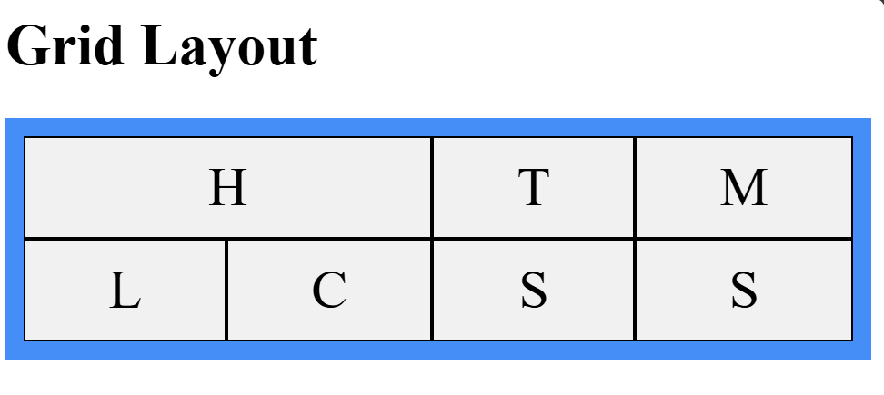
CSS Grid layout example 2
<html><head><style>
.container {
display: grid; grid-template-columns: auto auto auto auto; background-color: dodgerblue; padding: 10px; }
.container > div { background-color: #f1f1f1; border: 1px solid black; padding: 10px; font-size: 30px; text-align: center; }
.xx {grid-column-start: 1; grid-column-end: 3;}
</style></head><body><h1>Grid Layout</h1> <div class="container"> <div class="xx">H</div><div>T</div><div>M</div> <div>L</div><div>C</div><div>S</div><div>S</div>
</div> </body> </html>

Slide 65
Problem 2: Create a Responsive Navigation Bar
Objective: Develop a responsive navigation bar.
Instructions:
Write HTML to create a navigation bar with links (e.g., Home, About, Contact).
Use CSS to style the navigation bar:
Add a background color and hover effects for links.
Make it horizontal on desktop and vertical on smaller screens.
Use the "Responsive Design Mode" in the developer tools to test how the navigation bar looks on various devices.

Slide 66
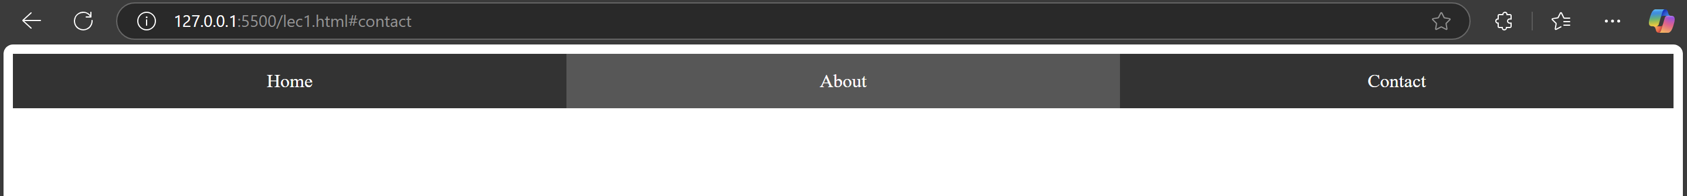
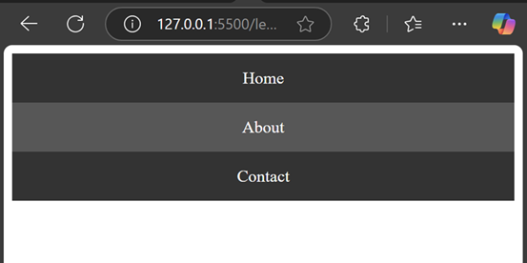
Problem 2 screenshot

Slide 67
<html> <head> <meta name="viewport" content="width=device-width, initial-scale=1.0">
<style> /* General styles for navigation bar */
.navbar { display: flex; background-color: #333; } .navbar a { flex-grow: 1; flex-shrink: 1; flex-basis: 0%;
padding: 14px 20px; text-align: center; text-decoration: none; color: white; } .navbar a:hover { background-color: #575757; } /* Media query for smaller screens */
@media (max-width: 600px) { .navbar { flex-direction: column; } }
</style></head><body> <div class="navbar">
<a href="#home">Home</a> <a href="#about">About</a>
<a href="#contact">Contact</a> </div> </body></html>

Slide 68
Problem 3: Design a Call-to-Action Banner
Objective: Build a visually appealing call-to-action (CTA) banner.
Instructions:
Write HTML to create a banner with a heading, a short description, and a button.
Style the banner using CSS:
Add a background image or gradient.
Position the text and button using Flexbox or Grid.
Use developer tools to experiment with spacing, fonts, and colors to make it eye-catching.

Slide 69
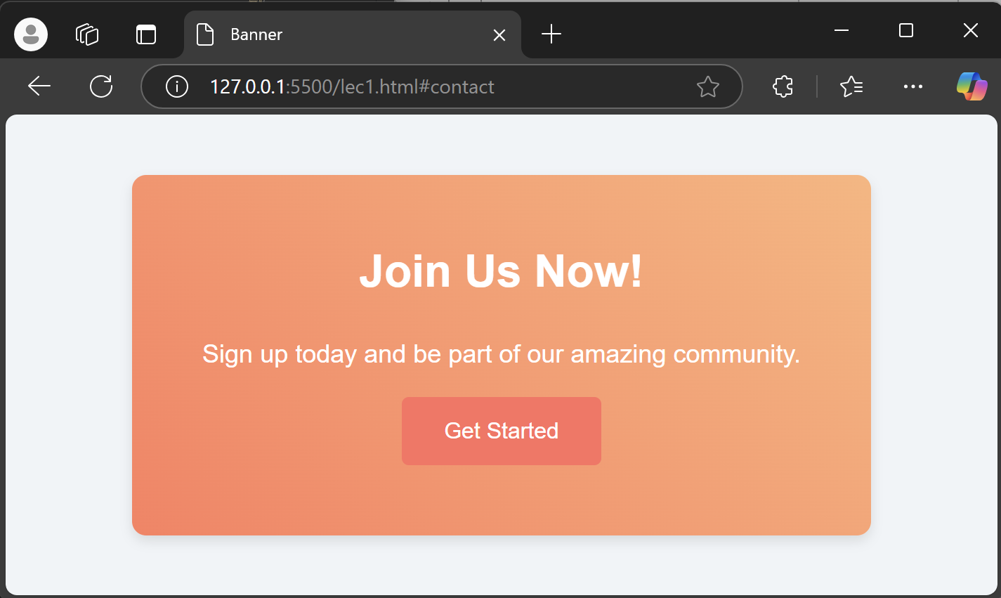
Problem 3: Task

Slide 70
CSS solution
<style>
body {
margin: 0;
font-family: Arial, sans-serif;
display: flex;
justify-content: center;
align-items: center;
height: 100vh;
background-color: #f0f4f8;
}
.banner {
background: linear-gradient(45deg, #ff7e5f, #feb47b);
color: white;
text-align: center;
padding: 50px;
border-radius: 10px;
box-shadow: 0 4px 8px rgba(0, 0, 0, 0.1);
}
.banner h1 {
margin: 0 0 30px;
}
.banner p {
margin: 0 0 20px;
font-size: 18px;
}
.banner button {
padding: 15px 30px;
font-size: 16px;
color: white;
background-color: #ff6f61;
border: none;
border-radius: 5px;
cursor: pointer;
}
.banner button:hover {
background-color: #ff4b3e;
}
/* Media query for smaller screens */
@media (max-width: 600px) {
.cta-banner {
padding: 30px;
}
}
</style>

Slide 71
HTML soution
<body>
<div class="banner">
<h1>Join Us Now!</h1>
<p>Sign up today and be part of our amazing community.</p>
<button>Get Started</button>
</div>
</body>

Slide 72
Problem 4: Add a CSS Animation to a Webpage
TODO takes: Explore the CSS properties to implement this task [25 minutes]
Objective: Implement a simple CSS animation.
Instructions:
Write HTML to create an element (e.g., a button or box).
Add CSS to apply an animation, such as:
A fade-in effect for the element.
A hover animation for the button to grow in size.
Use the browser's developer tools to adjust the animation duration and keyframes for smoothness.
Website Reference:
https://www.w3schools.com/w3css/w3css_animate.asp
https://www.w3schools.com/howto/howto_css_zoom_hover.asp

